Slide 1


Task
5
next slide
Tuqa Mazin
Adham Roushdy
Ahmed Abdulrhman

Slide 2


Introduction
02
🚕 Taxi Fare Prediction using Regression
Project objective: Predict taxi fare (fare_amount)
Based on various data (distance, time, weather, vehicle condition, etc.)
Type: Machine Learning – Regression Task
next slide

Slide 3



03
Data Preprocessing
🧹 Data cleaning and preparation
Remove missing and outlier values (e.g., fare < 0, or distance = 0)
Convert date to elements (hour, day, month)
Use One-Hot Encoding to represent weather, vehicle condition, and traffic conditions
Save data as cleaned_data1.csv
next slide

Slide 4



04
Modeling
Models used
LINEAR REGRESSION
RANDOM FOREST REGRESSOR
XGBOOST REGRESSOR
next slide

Slide 5

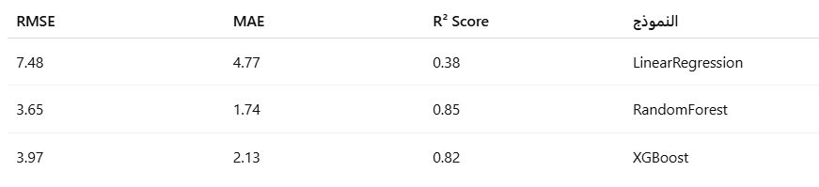
05
Evaluation
📊 Model performance comparison
Note:
🔸 Best model = Random Forest
🔸 Because it gave the highest accuracy and lowest error.
next slide

Slide 6

06
Conclusion
✅ What did we learn?
I learned how to intelligently prepare data.
I used regression models to accurately predict prices.
I was able to compare models and choose the best one.
Random Forest was the strongest at predicting.
This project is a practical example of using machine
learning in real-world applications, such as Uber or Bolt.
next slide

Slide 7


07
Why Regression not Classification?
Because fare_amount is a continuous real number,
it's not a class (like "expensive" or "cheap"),
That's why I used regression, not classification.
next slide

Slide 8
Thank You!

